Slide 1
Fraud Detection in Banking Data by Machine Learning Techniques
Review - 2
PROJECT GUIDE – PROF Dr.S.RATHI ME.,Ph.D
PRESENTED BY,
2018102 - AJMAL FARIZ M
2018113 - GOKUL R
2018L05 - ARAVIND M 2018L12 - KIRAN R V

Slide 2
Problem Description
To Develop and implement an efficient machine learning-based fraud detection system for Credit card banking data to:
Identify fraudulent transactions.
Minimize false positives.
Ensure adaptability and scalability.
Enhance customer trust.
Maintain compliance with regulations.
Continuously enhance fraud detection capabilities.
Prioritize data security and efficiency.

Slide 3
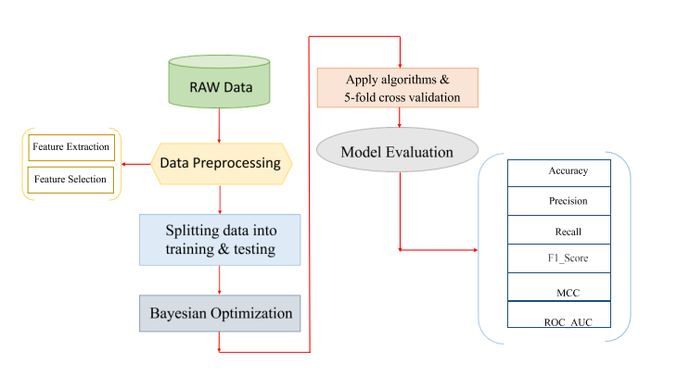
System functions

Slide 4
Module Description and Tools Usage
Implementation of Logistic regression
Implementation of LightGBM
Implementation of XGBoost
Implementation of CatBoost
Implementation of Majority Voting
Implementation of Artificial Neural Network
Tools
Python

Slide 5
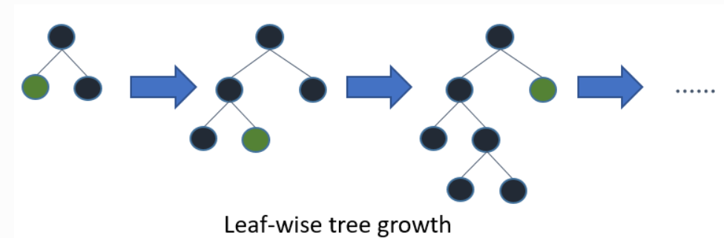
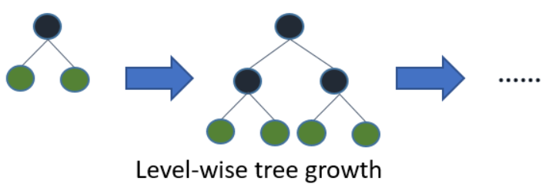
LightGbm
LightGBM is a gradient-boosting framework based on decision trees. It uses two novel techniques:
Gradient-based One Side Sampling(GOSS)
Histogram Based Tree Node Splitting
Exclusive Feature Bundling (EFB)

Slide 6
Gradient-based One-Side Sampling
Puts more focus on under-trained data points
We can use gradients as some measure of importance..
Small gradient: Means small error, the data point is learned well. (Not important).
Large gradient: Means large error, the data point is NOT learned well. (important)
The algorithm (with parameters a and b):
Sort the data according to absolute gradient value..
Keep the top ax100% of the data samples (large gradients).
Randomly sample bx100% from the rest of the data (small gradients)· Amplify small gradients by multiplying (1-a)/b when calculating information gain.

Slide 7
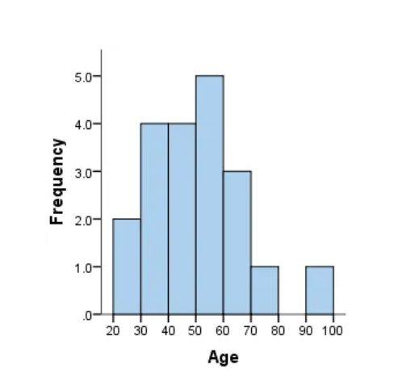
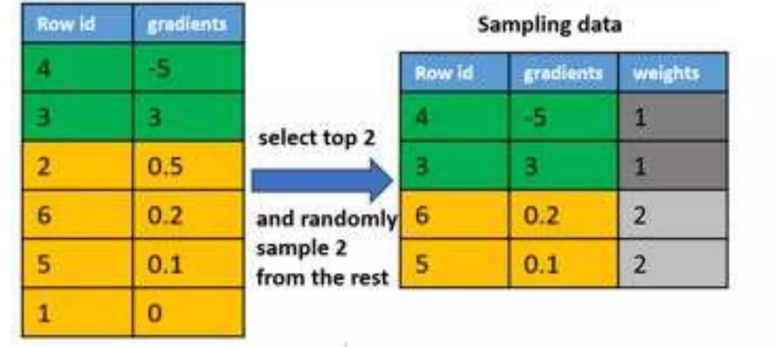

Histogram Based Tree Node Splitting
Gradient-based One Side Sampling(GOSS)

Slide 8
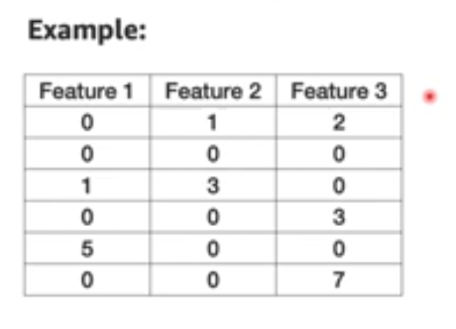
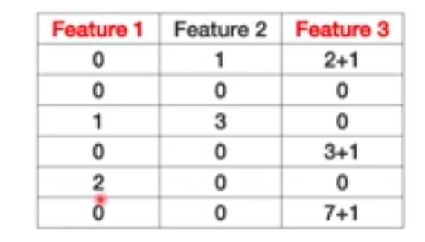
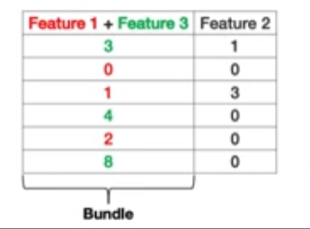
Exclusive Feature Bundling (EFB)
A nice way to reduce number of features by taking advantage of sparsity of large datasets.
The main observation is many features are never non-zero at the same time. Therefore, we can merge (bundle) them and save space by doing that.

Slide 9
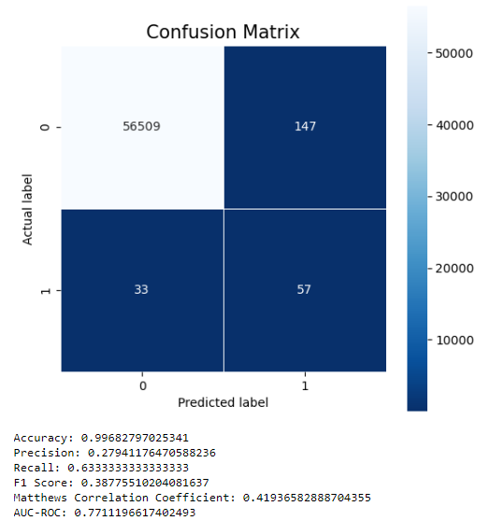
Lightgbm
Output

Slide 10
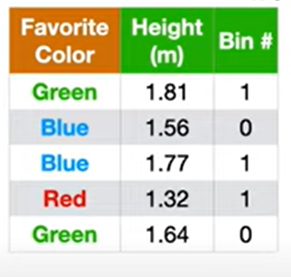
CatBoost
It provides a gradient boosting framework which among other features attempts to solve for Categorical features using a permutation driven alternative compared to the classical algorithm

Slide 11
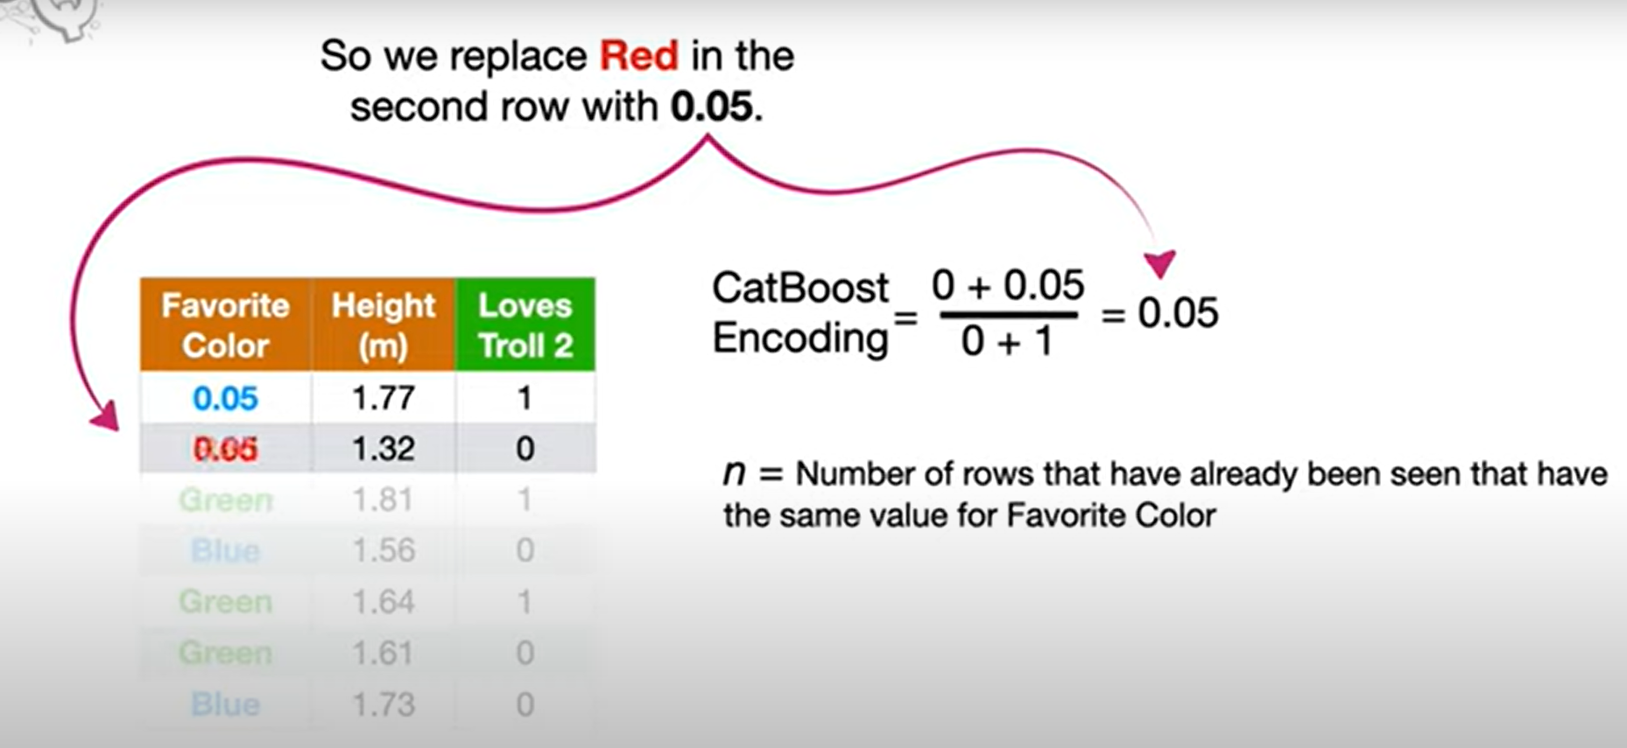
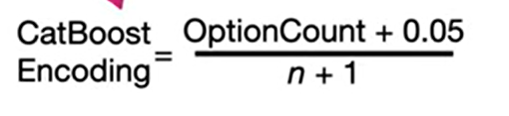
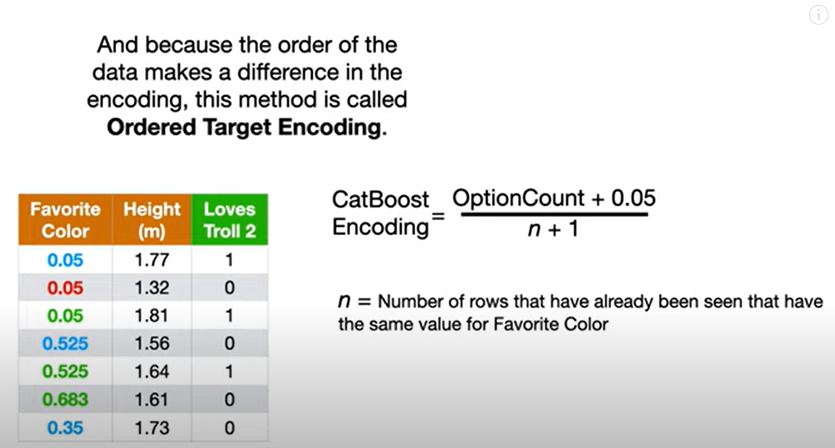

Slide 12
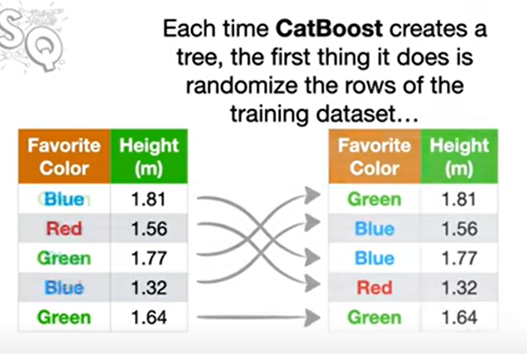
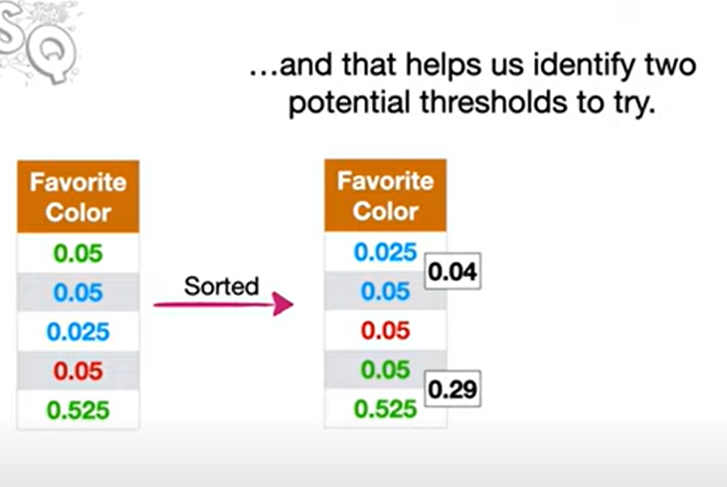

Slide 13
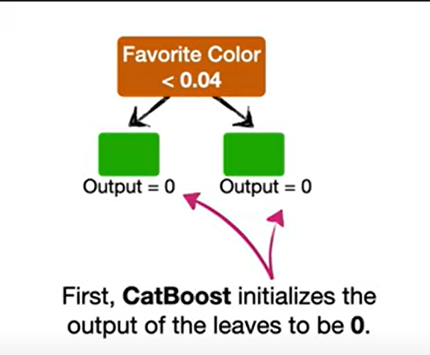
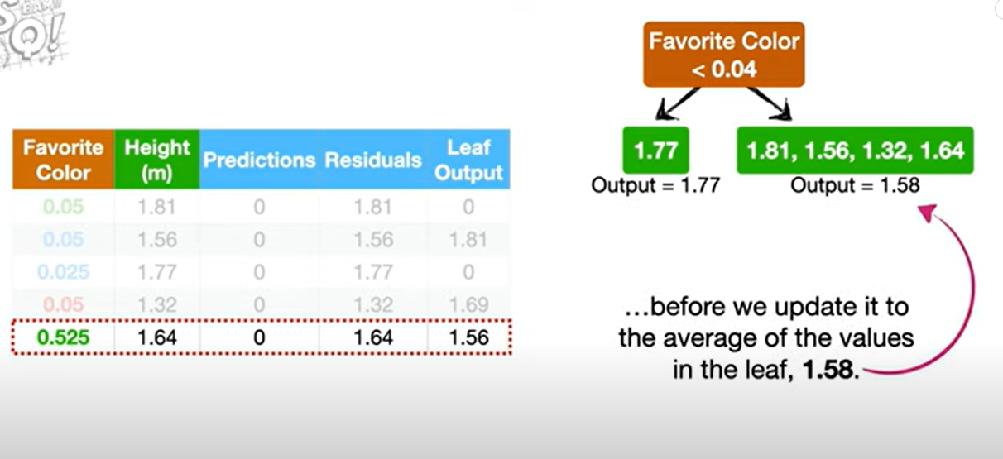

Slide 14
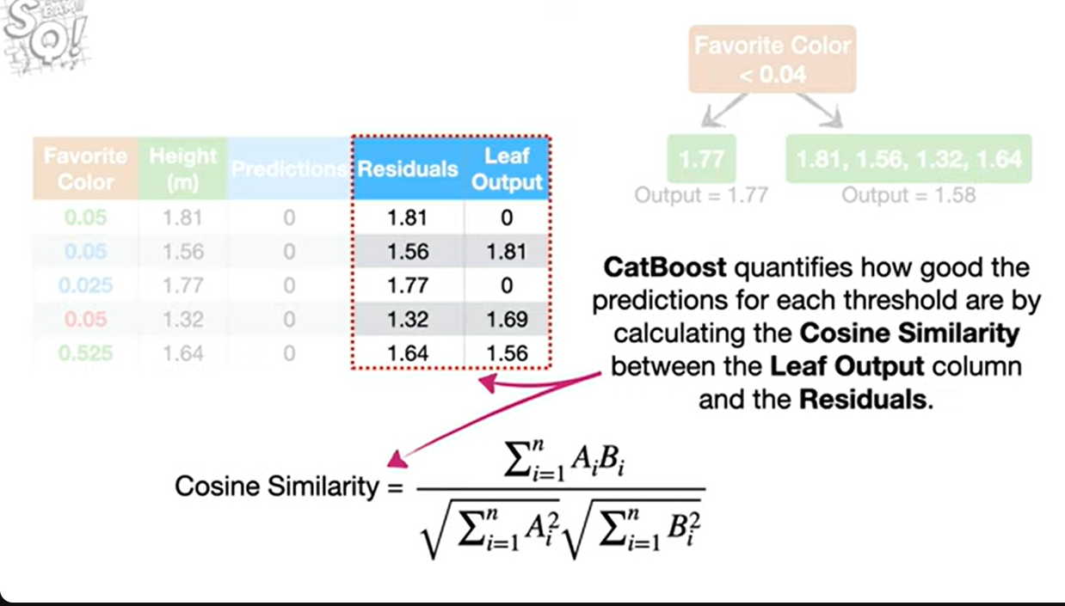
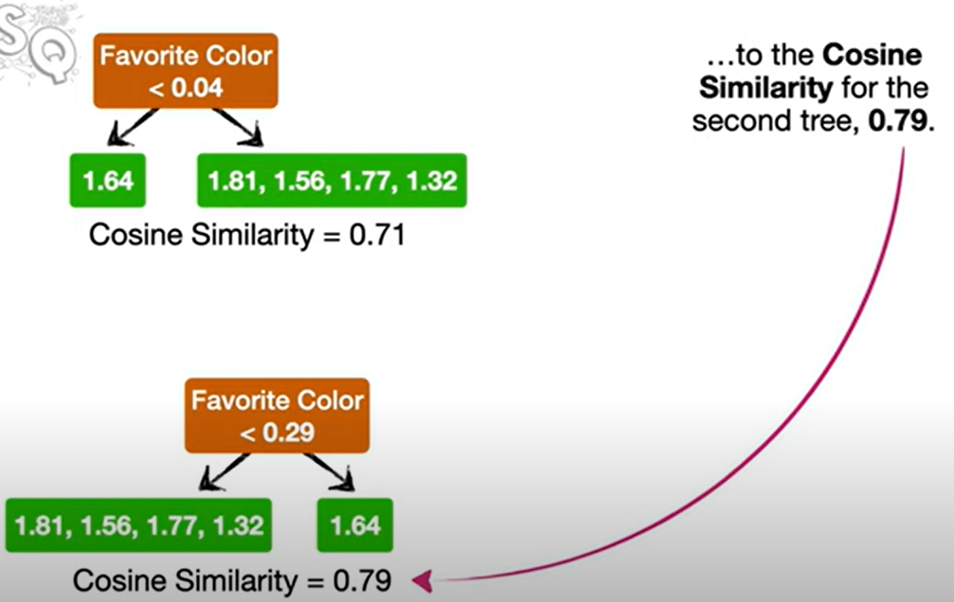

Slide 15
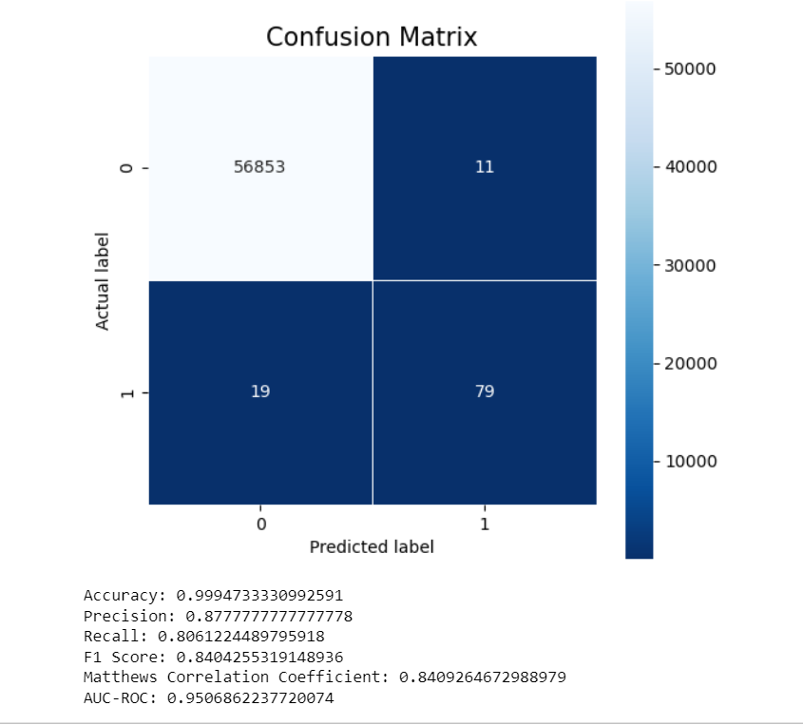
CatBoost
Output

Slide 16
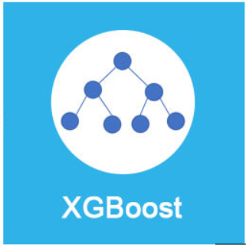
XGBOOST ALGORITHM
XGBoost is an extreme gradient boosting algorithm known for its speed and performance. It uses a set of decision trees to predict outcomes.
It makes use of the ‘‘max depth’’ parameter and starts tree pruning from the backward direction.
XGBoost is a machine learning algorithm that uses an ensemble of decision trees and gradient boosting to make predictions.
Xgboost uses the level-wise strategy grows the tree level by level.

Slide 17
Techniques:
Here are some key techniques and features associated with XGBoost:
Gradient Boosting Framework
Regularization Techniques
Tree Pruning
Gradient Boosting Framework :
Each tree corrects the errors of the previous one, gradually improving predictive performance.
Tree Pruning :
Pruning involves removing branches (nodes) from a tree to prevent overfitting and improve generalization .

Slide 18
Regularization Techniques :
XGBoost incorporates regularization techniques to prevent overfitting and enhance model generalization to unseen data .
The strength of regularization is controlled by hyperparameters like alpha (for L1 regularization) and lambda (for L2 regularization) in XGBoost.
For decision trees, regularization is achieved by controlling the tree’s depth and complexity.Maximum Depth(max_depth): Setting a limit on how deep the tree can grow. This is one of the most straightforward regularization methods.

Slide 19
IMPLEMENTATION :
Convert the data to DMatrix format :
DMatrix ( xgb.DMatrix )is used to convert the training and testing sets into the internal data structure .
Set the hyperparameters for XGBoost :
The tuned hyperparameters include learning rate, number of trees, and maximum tree depth, as well as applying weight to classes .
Evaluate the model

Slide 20
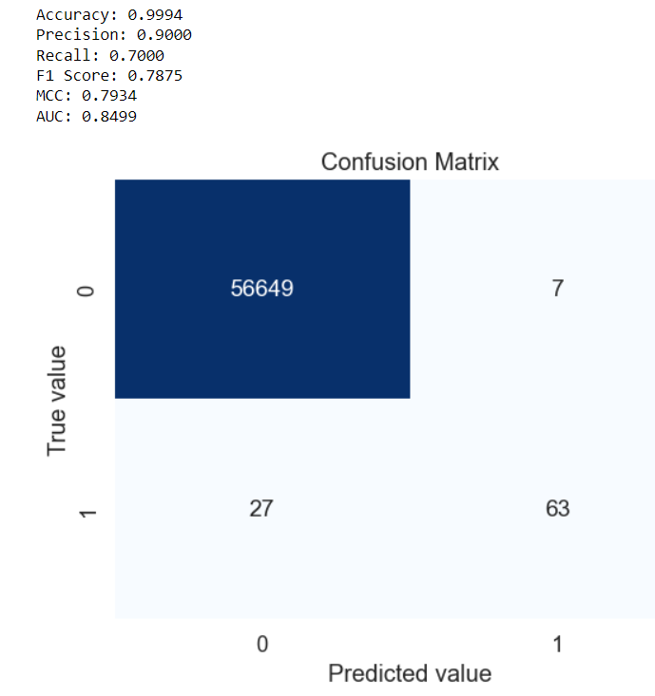
ADVANTAGES AND DISADVANTAGES :
Advantages of XGBoost:
Performance
Scalability
Customizability
Disadvantages of XGBoost:
Overfitting
Memory Requirements

Slide 21
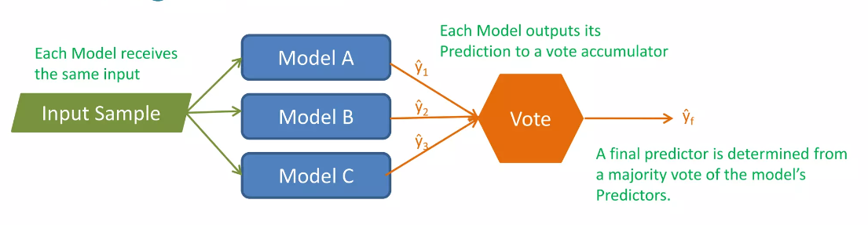
Majority Voting
An ensemble method is a combination of multiple and diverse models.
Each model in the ensemble makes a prediction.
A final prediction is determined by a majority voting among the models.

Slide 22
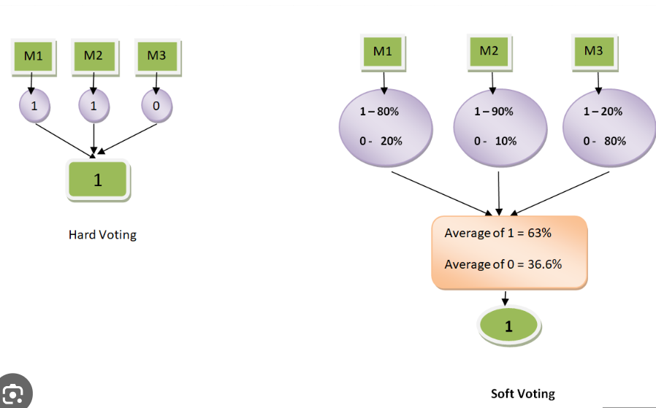
A voting majority classifier is not a real classifier, but a method that is trained and evaluated in parallel in order to use the different features of each algorithm
For a classification task, the class predicted by the majority of the models is considered the final prediction. For regression tasks, the average prediction from all models is taken.

Slide 23
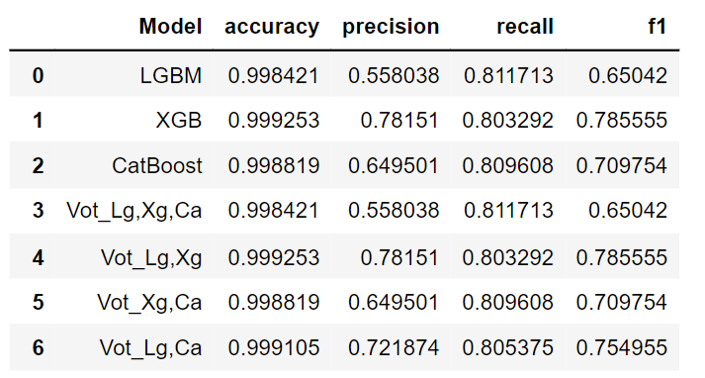

Slide 24
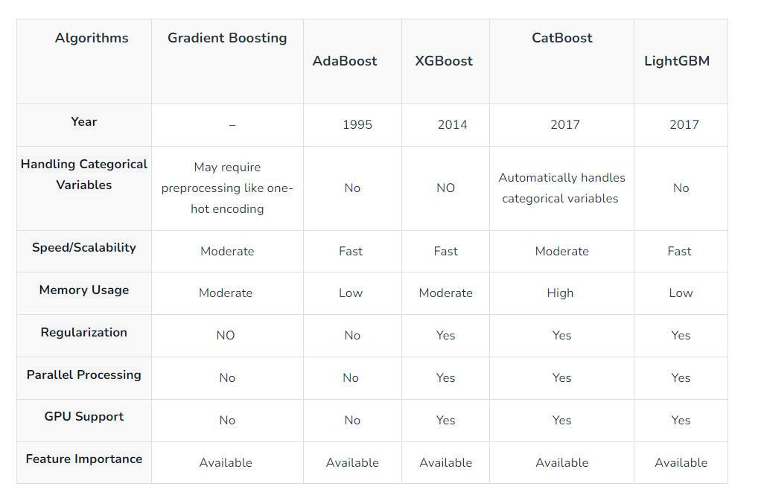
Comparison

Slide 25
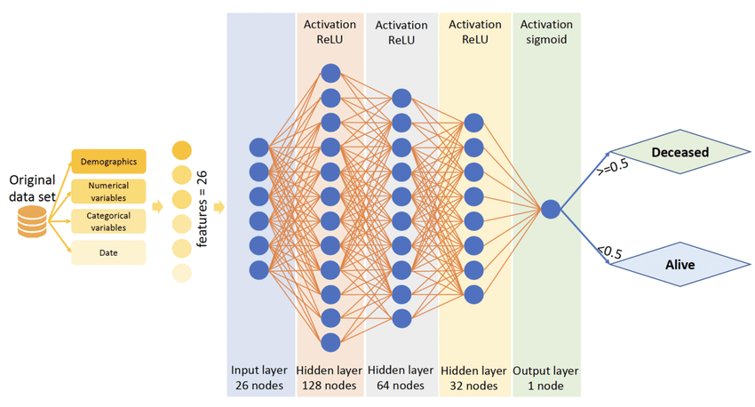
ANN
An Artificial neural network is usually a computational network based on biological neural networks that construct the structure of the human brain.
In order to define a neural network that consists of a large number of artificial neurons, which are termed units arranged in a sequence of layers.
Fraud
Non-Fraud

Slide 26
ANN
1. Initialize the Network:
- Define the number of input neurons (based on the features of your data).
- Define the number and size of hidden layers.
- Define the number of output neurons (based on what you are predicting or classifying).
- Initialize weights and biases for each neuron randomly.
2. Preprocess Input Data:
- Normalize or scale the data.
- Split the data into training and testing sets.
3. Define the Learning Parameters:
- Set the learning rate.
- Choose the activation function (e.g., ReLU, Sigmoid).

Slide 27
ANN
- Choose the loss function (e.g., Mean Squared Error for regression, Cross-Entropy for classification).
- Choose the optimizer (e.g., Gradient Descent, Adam).
4. Train the Network:
for each epoch:
for each batch in training data:
- Forward Propagation:
Calculate the output for each neuron from input to output layer.
Use the activation function to introduce non-linearity.
- Calculate Loss:
Compare the output of the network with the true values.
Backward Propagation
Calculate the gradients of the loss function with respect to each weight.
Update the weights and biases using the optimizer.

Slide 28
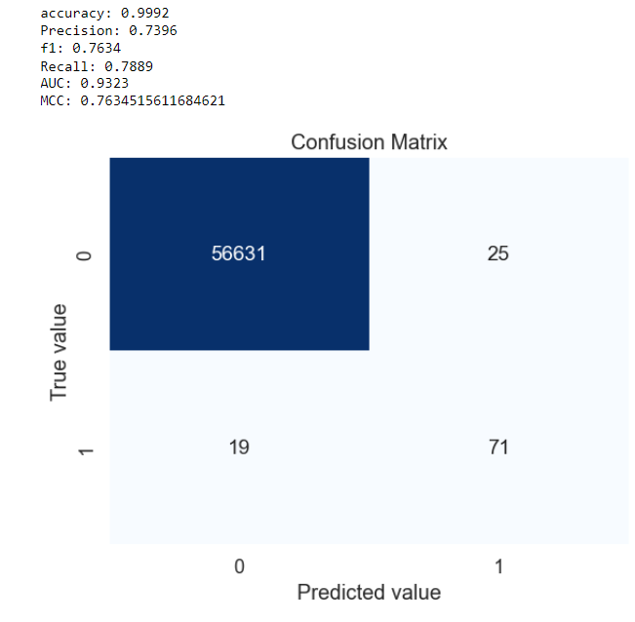
ANN
Output

